Slide 1

THIRD REVIEW Voice-enabled Chat-Bot for Admission Queries of SRM SRM Institute of Science and Technology CINTEL(Computational Intelligence) Department Project Category: PRODUCT SDG-4 Quality Education
Project guide-
DR. RESHMY AK SHREEYA CHAUHAN RA2111026010276
AMAAN MAJID RA2111026010178

Slide 2
Summary of all the Major Project Reviews
Review 0 :
We proposed an architecture using the LangChain library to incorporate our FAQ dataset.
We concentrated on the Information sourcing, designing a pipeline for prompt engineering and focusing on ways to reduce computation to train our existing model
We proposed the use of various chains in our model for different use-cases. One major use-case that we are focusing right now is the handling of the FAQ dataset.
We were planning out the format for our new dataset that would only include the FAQs.

Slide 3
Summary of all the Major Project Reviews
Review 1 :
We included an architecture using the LangChain library to incorporate our FAQ dataset.
We concentrated on the Information sourcing, designing a pipeline for prompt engineering and focusing on ways to reduce computation to train our existing model
We used various chains in our model for different use-cases. One major use-case that we are focusing right now is the handling of the FAQ dataset.
We incorporated the FAQ dataset by deeply web-scraping the website and checked for detailed results.
We lacked in an evaluation model and thus, we were advised to built one
Review 2 :
Created an evaluation metric.
The metric had issues in performance, as we were directly referring to the data

Slide 4
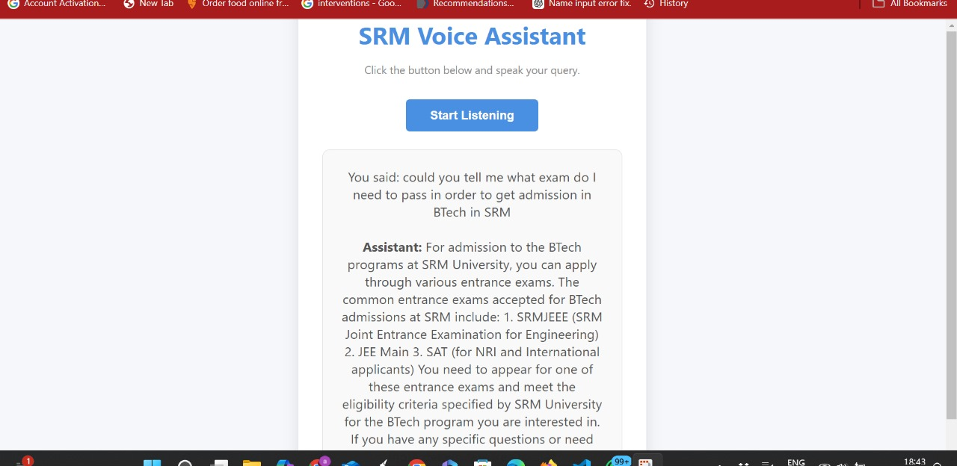
Summary of all the Major Project Reviews

Slide 5
Introduction
The SRM Admission Chatbot was designed to simplify and enhance the admissions process for students. It provides instant, accurate responses to admission-related queries through both voice and text interfaces. By leveraging advanced power of openAI and FAQ integration, we can reduce the response time and improve user experience of the upcoming students.
Motivation: The admissions process at universities often involves repetitive queries about eligibility, deadlines, and fees. Traditional methods like email or phone support are time-consuming and may lead to delays. To handle these repetitive queries easily, we are incorporating a set of FAQs(Frequently Asked Questions) into our existing model, with some architectural changes. The voice assistant’s ability to handle these repetitive questions would reduce the human effort being put in answering the same questions again and again.

Slide 6
Introduction
Why This Project?
To ensure prospective students have 24/7 access to accurate information.
To minimize the workload on admissions office staff.
To improve engagement and trust with applicants.
Potential Impact:
Reduces dependency on manual support systems.
Enhances the accessibility of admissions information for diverse audiences.
Lays the groundwork for AI-driven automation in higher education services.

Slide 7
Problem Statement
Admissions offices face a high volume of repetitive queries, such as:
“What are the eligibility criteria for a B.TECH in CSE with AI/ML program?”
“When is the application deadline?”
“What is the fee structure for law courses?”
The current manual approach is inefficient, leading to delays and potential frustration among prospective students.
Challenges in this domain:
High Query Volume:
Repetitive queries overwhelm the admissions team, leaving less time for personalized or complex concerns.
Inefficiency in Communication:
Lack of instant responses can discourage applicants.
Existing systems often fail to provide contextually relevant information promptly.

Slide 8
Problem Statement
3. Gaps in Automation:
Current chatbots struggle with combining static FAQ responses and dynamic AI-generated answers.
Many systems lack robust voice-enabled interaction capabilities, reducing accessibility.
Concluding the problem statement: “To addresses gaps in admission queries management by combining FAQ integration and AI-driven conversation flow, ensuring a seamless and efficient admissions experience for students.”

Slide 9
Objectives
Objective 1: Build a data of Frequent Admission Queries.
Integrate Frequently Asked Questions (FAQs) and other relevant data from the webpage into the chatbot.
Integrate the set of FAQs given by the admissions office
Ensure accurate, up-to-date information is readily available to answer common queries.
Objective 2: Increase Efficiency by training the model over FAQ Responses
Automate responses to frequently asked questions, reducing manual intervention and response time.
Streamline the admissions process by providing quick and accurate answers to repetitive queries.
Objective 3: Leverage Advanced Natural Language Processing (NLP) Techniques like prompt engineering
Utilize LangChain for dynamic query processing, ensuring context-aware responses.
Apply prompt engineering to combine static FAQs with dynamic AI-generated answers for a seamless interaction.

Slide 10
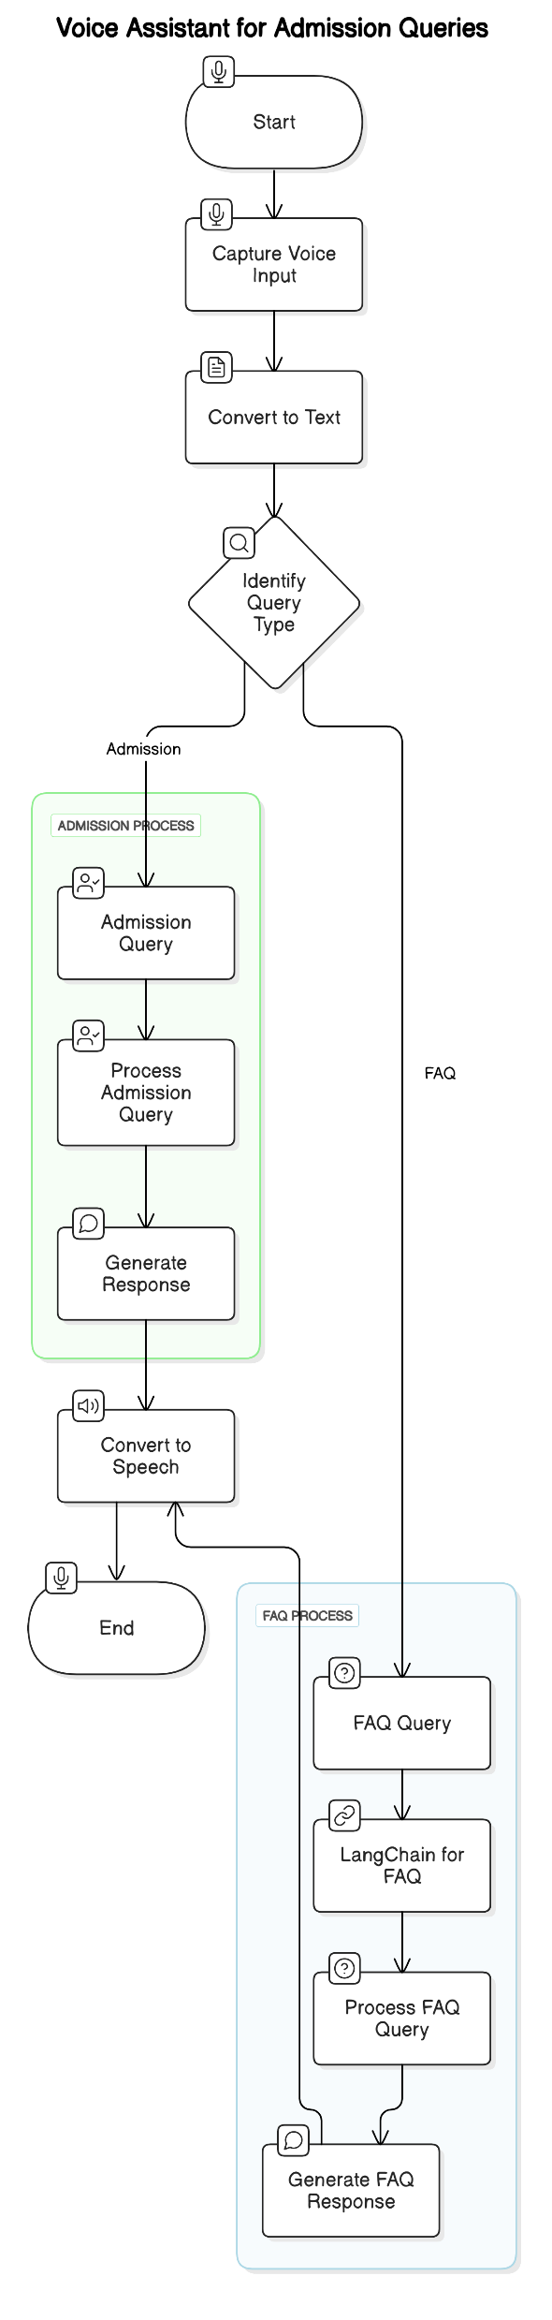
End Product Representation
Current Focus
External 2nd layer/chain
Evaluation

Slide 11
Abstract
This project focuses on fine tuning our voice-enabled chatbot to streamline the admissions process for educational institutions. The chatbot will provide prospective students with information related to FAQs like institution's programs, application procedures, and admission criteria. It will also help users to keep a track of important deadlines, understand required documents, and access details about tuition fees and available scholarships. By using openAI’s advanced natural language processing capabilities, the chatbot will interact with users in a conversational manner, offering precise and contextually relevant responses. This voice-enabled feature ensures that information is accessible and user-friendly, catering to those who prefer or require auditory interactions. The chatbot aims to enhance the admissions experience by reducing the need for manual intervention from admissions staff, thus improving overall efficiency. Utilizing advanced natural language processing and prompt engineering , it will deliver accurate and timely responses in a conversational format. This tool is designed to enhance user experience by offering immediate and accessible support, ultimately streamlining the admissions process and improving efficiency for both students and the institution.

Slide 12
Old System
The current chatbot system is designed to efficiently handle admission-related queries for SRM University. It provides both text-based and voice-enabled interactions, making it accessible to a diverse audience. The architecture integrates advanced tools and frameworks to deliver fast, accurate, and context-aware responses.
The chatbot accepts user queries through voice or text.
It processes queries using the LangChain model for contextual and detailed responses.
Backend built with FastAPI manages API requests and responses.
The chatbot does not have any evaluation metric

Slide 13
New Developments
The updated chatbot system focuses on efficiently handling FAQs with a separate chain dedicated to frequently asked questions.
We have developed a separate format for representing our FAQ dataset
We have web-scraped the SRM University website and developed a FAQ Dataset
We have successfully developed a separate chain with the help of our LangChain library to feed the FAQ dataset
By using a separate chain just for the FAQs, the efficiency and accuracy of the chatbot will increase and its overall work will be a lot smoother.
A new evaluation metric was created called perplexity score.

Slide 14
Evaluation Metric within LangChain
Language models need careful monitoring to ensure they work well across different inputs and software components. Reliability means making sure responses are accurate, useful, and consistent.
Production environments need repeatable and reliable outcomes.
Evaluation helps measure model performance and integrity.
When deploying LLMs, we want to ensure they function consistently. Evaluation helps us measure their effectiveness and avoid mistakes when updating models.
LangChain offers built-in evaluators to measure different aspects of model performance.
Supports custom evaluators for unique project needs.
Evaluators integrate with LangSmith for tracking and debugging.
LangChain provides tools to test and monitor LLM-based applications. LangSmith helps track errors and improve models over time.

Slide 15
Types of Evaluators in LangChain
String Evaluators: Compare model outputs with reference responses.
Trajectory Evaluators: Analyze the sequence of actions taken by an agent.
Comparison Evaluators: Compare two model outputs for the same input.
Different tasks require different evaluation methods. String evaluators check text accuracy, trajectory evaluators track decision-making, and comparison evaluators determine which response is better.
Real World Uses :
Chain Comparisons: Compare different model chains and measure confidence levels.
LangSmith Evaluation: Integrated framework for tracking performance.
Preventing Regressions: Identify issues early and improve model output.
Evaluators help us compare different approaches and track how well a model performs over time, avoiding unexpected drops in accuracy.

Slide 16
Perplexity Score
The methods mentioned are dependent on exact string matching from reference but our chat bot is robust and more interactive it doesn’t use exact answers so string matching and other evaluations won’t work.
Taking this into consideration, we are using perplexity score.
We used ChatGPT-2 to measure the perplexity score of our GPT-3.5-based bot because GPT-3.5 doesn’t provide perplexity directly. GPT-2, being open-source, allows us to estimate how predictable and coherent our bot’s responses are. A lower perplexity means better confidence, while a higher perplexity suggests uncertainty. This helps us benchmark response quality and track improvements.
Thus fulfilling the task appointed during the last review.

Slide 17
Perplexity Examples
Model | Dataset | Cross-Entropy Loss | Perplexity (PPL) | Interpretation
GPT-3 (175B) | News Articles | 2.1 | 8.16 | Lower perplexity → More confident predictions
GPT-2 (1.5B) | News Articles | 3.5 | 33.12 | Higher perplexity → More uncertain predictions
LLaMA 2 (7B) | Wikipedia | 2.3 | 9.97 | Moderate perplexity, good performance
BERT (base) | Scientific Papers | 4.0 | 54.60 | Very high perplexity, struggles with dataset
Small RNN | Wikipedia | 5.2 | 180.59 | Very high perplexity → Poor predictions

Slide 18
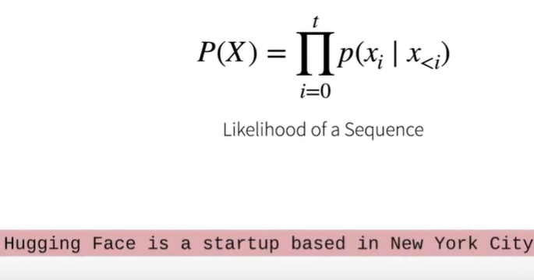
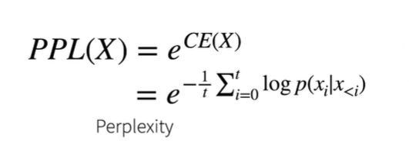
Calculating Perplexity
1) Likelihood of a sequence is calculated as the product probability of all the tokens within the a sentence
2) Cross-entropy is the loss function in classification tasks(predicting the next word). This perplexity is thus a function of loss and also a function of likelihood

Slide 19
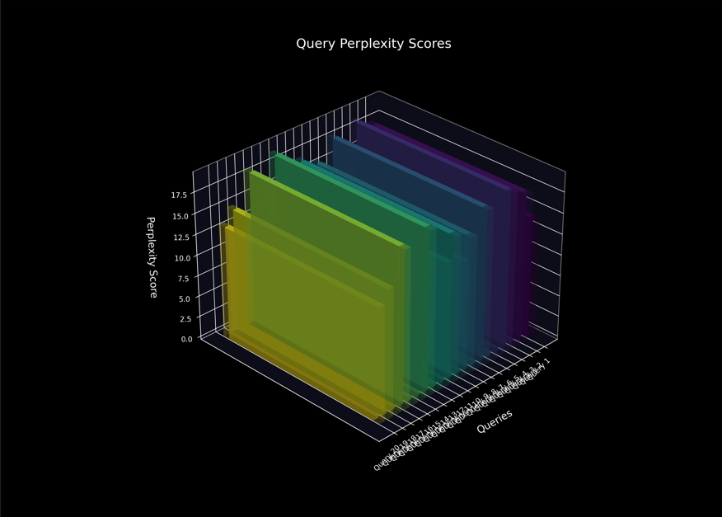
Perplexity Graph
This is the perplexity graph that we have gotten after analyzing 20 queries and taking their perplexity score and making a graph out of it.

Slide 20
Dataset
The dataset is built by web scraping existing FAQs and structuring them for seamless integration with the chatbot system. We further plan on to increase the dataset size by directly incorporating the FAQs given to us by the admissions office. A glimpse of our dataset-
Question | Answer
Do you accept demand drafts for tuition fees? | No. Only online payments are accepted.
What payment methods are available for tuition fees? | Pay through Net Banking, Credit and Debit Card, UPI.
Are weekly assessments/assignments compulsory? | Yes. It is a part of Continuous Assessment. Once you complete the current week's assessments/assignments, then only, you will be able to proceed to the next week's learning content on the SRM Online Learning Platform.
Is there any attendance criteria to appear for semester/end term examination? | Online mode: The learner should have minimum participation of 75% in all the activities of the online programme prior to the end semester examination or term-end examination as per UGC.

Slide 21
Dataset Format
Format: The dataset is structured in JSON format.
Components:
Instruction: Query type or user intent.
Output: Chatbot responses.
Source: Data has been taken from the SRM website, with further fine-tuning planned. Example-
[
{
"query": "Do you accept demand drafts for tuition fees?",
"response": "No. Only online payments are accepted."
},
{
"query": "What payment methods are available for tuition fees?",
"response": "Pay through Net Banking, Credit and Debit Card, UPI."
}
]

Slide 22
Prompt Engineering using the LangChain Library
What is LangChain?
LangChain is a framework designed for building applications powered by large language models (LLMs).
It provides tools to integrate LLMs with external data, memory, and advanced user interfaces.
LangChain in SRM Chatbot:
Used to process dynamic queries that require AI responses.
Memory feature stores user session data for personalized interactions.
Combined with FastAPI for quick deployment.

Slide 23
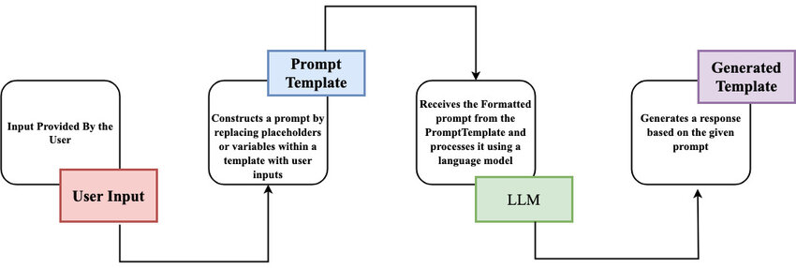
Prompt Engineering using the LangChain Library

Slide 24
Incorporating FAQS- Methodology
The process of incorporating FAQs into the chatbot leverages LangChain’s capabilities to handle structured prompts effectively. By embedding FAQ answers into a single, well-crafted prompt template, the chatbot becomes more efficient at resolving repetitive queries.
Methodology:
Create an FAQ Template:
Consolidate all FAQs into a single prompt template, including both questions and their respective answers.
Example:
FAQ Section: Q: What is the application deadline? A: The deadline is December 15, 2024. Q: What is the fee for the law program? A: The annual fee is ₹2,00,000. User Query: {user_input}
2. Incorporate into LangChain:
Embed the FAQ template into the chatbot’s LangChain prompt logic.
Modify the existing prompt to include FAQs as context:

Slide 25
Incorporating FAQS- Methodology
from langchain_core.prompts import ChatPromptTemplate
prompt = ChatPromptTemplate.from_messages( [ ("system", "You are a helpful assistant specializing in SRM admissions. Answer questions based on the following FAQs:\n" "Q: What is the application deadline?\nA: The deadline is December 15, 2024.\n" "Q: What is the fee for the law program?\nA: The annual fee is ₹2,00,000.\n\n" "If the user's question is not in the FAQs, answer it to the best of your ability."),
("user", "{user_input}") ] )
3. Enhance Matching with Prompt Engineering:
Use prompt engineering to guide the model in prioritizing FAQ answers if they match the query.
Example instruction to the model: "If the query aligns with an FAQ, respond with the corresponding answer. If it doesn't, rely on your general knowledge to assist the user."

Slide 26
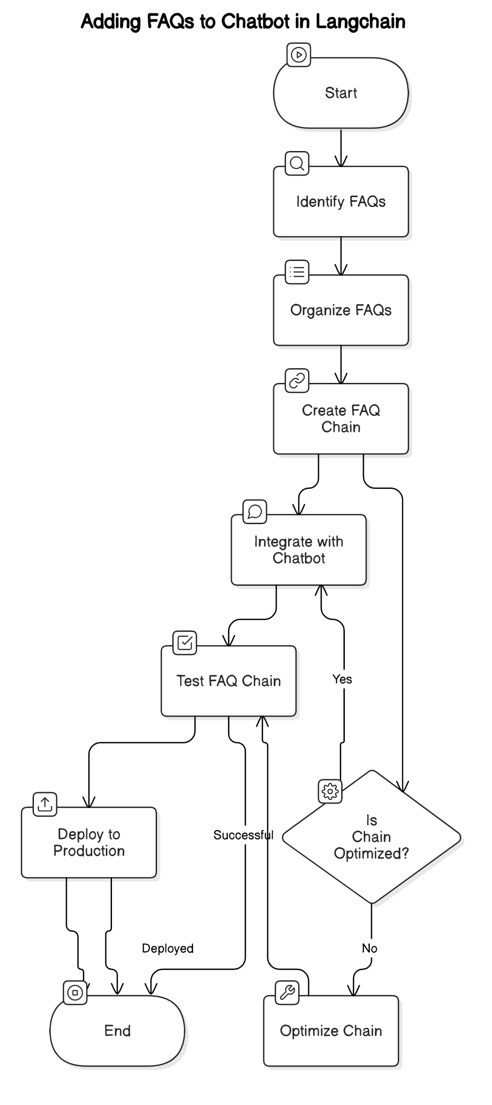
Incorporating FAQS- Methodology Flow Chart

Slide 27
Expected Outcomes
1. A Formatted dataset of FAQS
At the end of this project, we can expect a dataset incorporating most of the FAQs related to admission queries.
The dataset would comprise of the web scrapped questions and the private FAQ data given to us by the admissions office.
2. 24/7 Availability and Accessibility
Applicants will have access to admission-related information at any time, improving user satisfaction and engagement.
Multilingual and voice-enabled capabilities will make the system more inclusive and accessible to a wider audience.
3. Reduced Operational Costs
By automating FAQ responses, the admissions office will experience reduced workload on staff, leading to cost savings in terms of labor.
Automation will also reduce the need for dedicated call centers or email support for routine queries.
4. Improved Response Accuracy and Evaluation Metrics
With the integration of the perplexity (PPL) score, we can now evaluate the chatbot’s response quality more effectively.
A lower PPL score indicates better fluency and coherence in answers, ensuring that responses align closely with user expectations. This metric will help fine-tune the model for continuous improvement in accuracy and relevance

Slide 28
Product Backlog Refinement
Epic 1: Application Deadlines
User Story:
As a prospective student, I want to know the application deadlines for different programs so that I can apply on time.
Acceptance Criteria:
The chatbot provides the correct deadlines when asked.
Deadlines are specific to the selected program.
Epic 2: Program Information
User Story:
As a prospective student, I want to learn about the courses available in my chosen program so that I can make an informed decision.
Acceptance Criteria:
The chatbot provides accurate course details when requested.
The information includes course duration, content, and outcomes.

Slide 29
Product Backlog Refinement
Epic 3: Fee Structure
User Story:
As a prospective student, I want to know the fee structure for SRM programs so that I can plan my finances.
Acceptance Criteria:
The chatbot provides accurate fee details for SRM programs when asked.
Fee information is specific to the selected SRM program.
Epic 4: Program Duration
User Story:
As a prospective student, I want to know the duration of SRM programs so that I can plan my studies accordingly.
Acceptance Criteria:
The chatbot provides accurate program duration for SRM programs when asked.
Duration details are specific to the selected SRM program.

Slide 30
Product Backlog Refinement
Epic 6: Contact Information
User Story:
As a prospective student, I want to get contact details for SRM's admissions office or relevant departments so that I can ask further questions.
Acceptance Criteria:
The chatbot provides correct contact information for SRM admissions and relevant departments.
Contact details include email, phone number, and office hours.
Epic 7: Application Process
User Story:
As a prospective student, I want detailed instructions on how to apply for any SRM program so that I can complete the application correctly.
Acceptance Criteria:
The chatbot guides users through the SRM application process step-by-step.
Users receive clear and concise instructions tailored to SRM's application requirements.

Slide 31
Product Backlog Refinement
Epic 8: Follow-Up Question Suggestions User Story: As a prospective student, I want the chatbot to offer follow-up questions or additional context based on the FAQ I asked so that I can explore related information effortlessly.
Acceptance Criteria:
The chatbot suggests follow-up questions related to the user’s initial FAQ query.
Follow-up suggestions include options like “Would you like to know about the documents required for admission?” or “Do you want to check the deadlines for application?”
Epic 9: Handling Ambiguous Queries User Story: As a prospective student, I want the chatbot to handle unclear or incomplete questions about FAQs gracefully so that I can still receive useful guidance.
Acceptance Criteria:
The chatbot provides clarification prompts, like “Could you please clarify if you’re asking about the admission fee structure?”

Slide 32
Product Backlog Refinement
Epic 10: FAQ Search by Category
User Story: As a prospective student, I want the chatbot to categorize FAQs by topics like fees, application process, or scholarships so that I can quickly find relevant answers.
Acceptance Criteria:
Users can select categories, and the chatbot displays FAQs related to that category (e.g., “Scholarships” shows queries like “What are the available scholarships?”).
The chatbot allows switching between categories and retrieving accurate answers promptly.
Epic 11: Evaluation Metrics for Response Quality
User Story: As a system evaluator, I want the chatbot’s responses to be assessed using perplexity (PPL) scores and other evaluation metrics so that I can ensure high accuracy and coherence in generated answers.
Acceptance Criteria:
The chatbot computes a perplexity score for each response, with lower scores indicating better fluency and relevance.
Evaluation metrics like response accuracy, response time, and user feedback ratings are collected to improve chatbot performance.
The system periodically reviews evaluation scores and updates the model for continuous optimization.

Slide 33
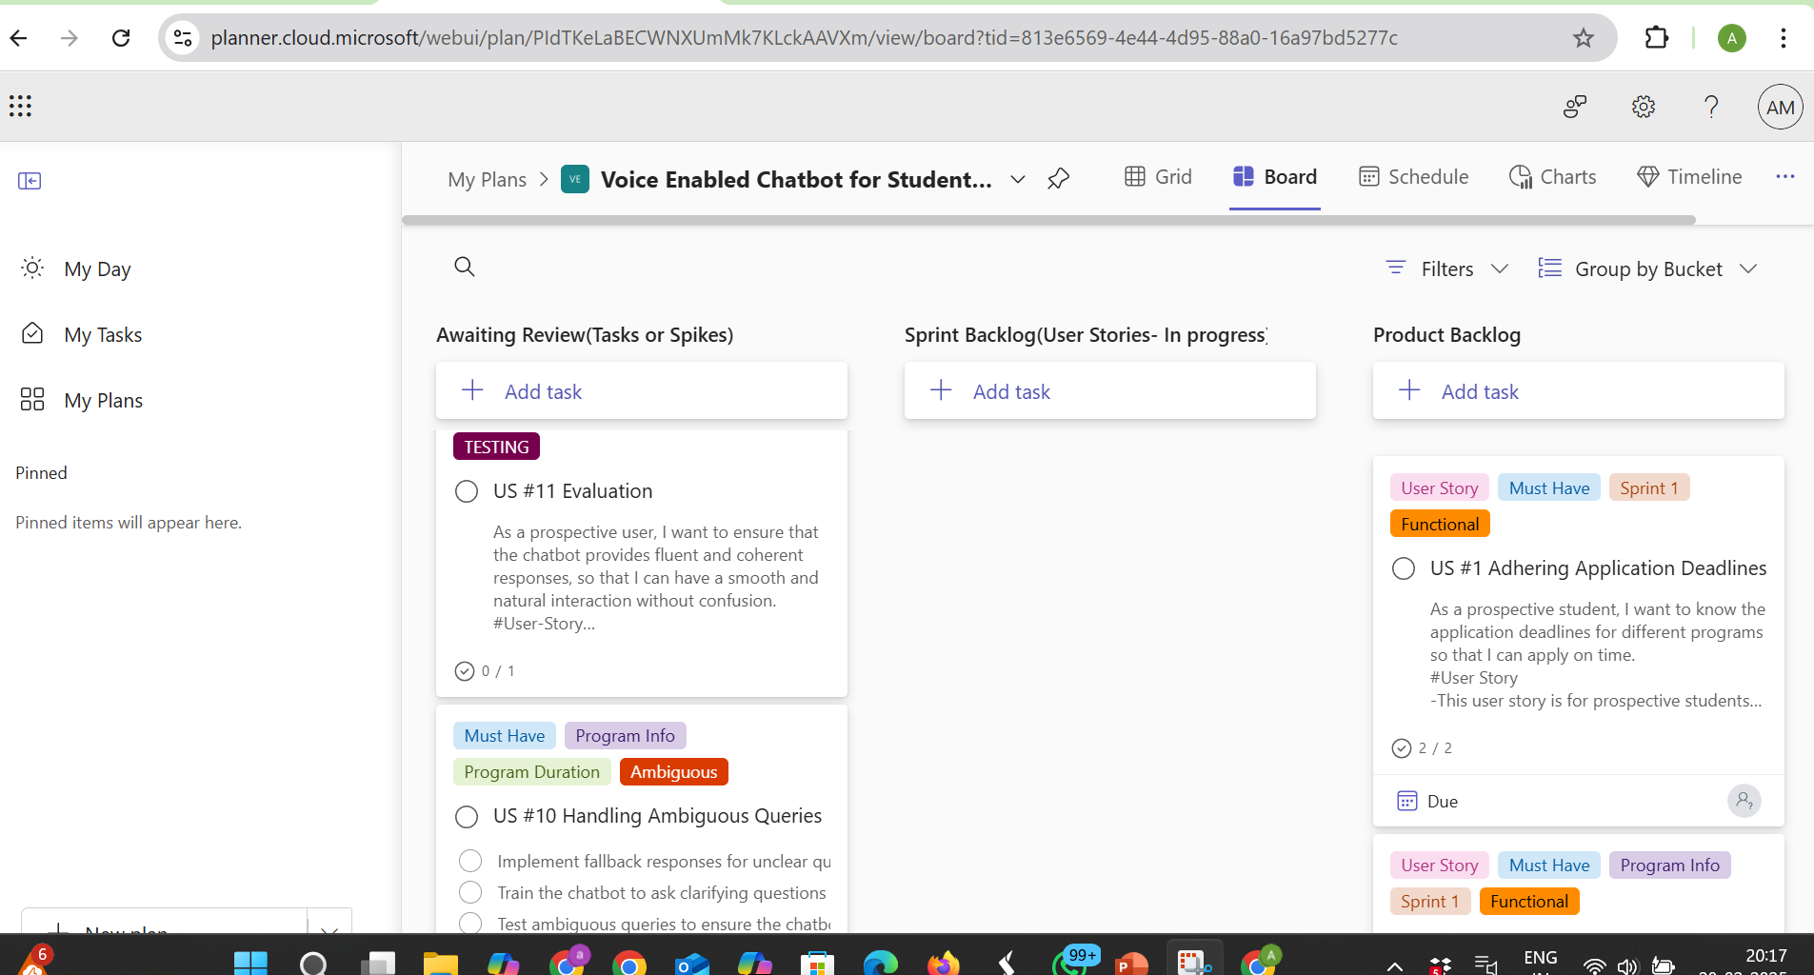
Product Backlog on MS Planner

Slide 34
Sprint Backlog Refinement
Current Focus: Evaluation Metrics for Response Quality
User Story: As a system evaluator, I want the chatbot’s responses to be assessed using evaluation metrics like perplexity (PPL) scores so that I can ensure high accuracy, coherence, and relevance in generated answers.
In our ongoing sprint, the primary focus is on implementing evaluation metrics to measure and refine the chatbot’s performance. The team is working on integrating perplexity scoring, response accuracy tracking, and user feedback analysis to improve response quality.
This process aims to ensure that the chatbot provides clear, precise, and contextually relevant responses. By continuously monitoring these metrics, we strive to enhance the chatbot’s reliability, coherence, and overall effectiveness in handling admission-related queries.

Slide 35
Tasks-
1. Collect and Tokenize Chatbot Responses
Gather chatbot-generated responses for various admission queries.
Tokenize responses to prepare them for perplexity calculation.
2. Compute Perplexity Using a Pre-Trained Model
Use a language model (e.g., GPT-2) to compute PPL scores for chatbot responses.
Calculate perplexity as PPL=e1N∑i=1N−log⁡P(wi)PPL = e^{\frac{1}{N} \sum_{i=1}^{N} -\log P(w_i)}PPL=eN1​∑i=1N​−logP(wi​).
3. Visualize and Analyze Perplexity Trends
Plot a graph showing perplexity scores over different chatbot versions.
Identify trends and optimize model responses based on PPL evaluation.

Slide 36
Example Dataset for FAQs
Instruction | Input | Output
How many specializations are offered in MBA? | Finance, Marketing, Human Resource Management, Business Analytics, Health Care and Hospital Management (Starting July 2024), Logistics and Supply Chain Management, AI and Data Science. | Finance, Marketing, Human Resource Management, Business Analytics, Health Care and Hospital Management (Starting July 2024), Logistics and Supply Chain Management, AI and Data Science.
Do you have any collaboration with hospitals for MBA (Health Care & Hospital Management)? | Yes, an MOU has been executed with SRM Global as a knowledge partner. | Yes, an MOU has been executed with SRM Global as a knowledge partner.
Are MBA and MCA recognized by the All India Council of Technical Education (AICTE)? | Yes our MBA and MCA Programme are recoginized by AICTE. | Yes our MBA and MCA Programme are recoginized by AICTE.
Mode of Application Form? | The application form is available online only. | The application form is available online only.
Cost of Online Application? | Rs. 500 for Indian nationals and $15 for International students. | Rs. 500 for Indian nationals and $15 for International students.

Slide 37
Sprint Activities-Daily Scrum
What did we do last month?
Successfully developed the web-scraped Dataset and the LangChain system.
What are we doing today?
Currently including more information to be fed into the model from the admissions office and working on more evaluation techniques
Any blockers?
Facing difficulties in setting up string-based evaluators

Slide 38
Sprint Activities-Daily Scrum
Meetings were done on-
December 3rd 2025
December 7th 2025
December 14th 2025
January 8th 2025
January 20th 2025-Meeting with project guide and admissions office
January 21st 2025-Meeting with the admissions office
February 11, 2025
February 12, 2025
February 21, 2025
February 27, 2025

Slide 39
Sprint Activities-Functional Document
Section | Details
1. Introduction | Objective: Enhance interaction between prospective students and SRM University via a voice-enabled chatbot that handles the FAQs very well. Sprint 1 Focus: Implement key functionalities like FAQs on admission deadlines, course information, and personalized voice greetings.
2. Product Goal | Primary Goal: Update the voice-enabled chatbot to assist prospective students with admission queries and FAQs, improving their decision-making.
3. Demography | Users: Target Users: Prospective students, current students, SRM administrators. User Characteristics: Varying academic interests and technical skills; administrators requiring real-time data management. Location: - Target Location: Primarily India, but globally accessible.

Slide 40
Sprint Activities-Functional Document
Section | Details
4. Business Processes | Key Processes: User Interaction and Query Handling: Voice command interaction for retrieving admission, course, and fee information. Information Retrieval: Display answers to FAQs of admission deadlines, course details, fee structures, and contact info. Perplexity evaluation: Chatbot processes voice input to text output, perplexity evaluation will be applied to text generation part of the chatbot to ensure reliable and fluent responses.
5. Assumptions | Voice recognition and response systems will work accurately across devices and environments. Content managers will regularly update admission and course data. Users will have stable internet connections. Stakeholders will provide timely feedback and content updates.

Slide 41
Sprint Activities-Functional Document
Section | Details
6. Features | Core Features for Sprint 1: - FAQ Handling Admission deadlines Extra contextual information along with the FAQ answer Up-to-date payment methods Program duration details Handling unclear FAQs Categorising the FAQs based on their domain Application-related information
7. Authorization Matrix | Roles and Access Levels: Administrator: Full access to manage content and settings. Content Manager: Update and manage admission-related data. Student: Access to personalized greetings and admission information. Prospective Student: Access to general admission and course info Guest User: Limited access to basic queries.

Slide 42
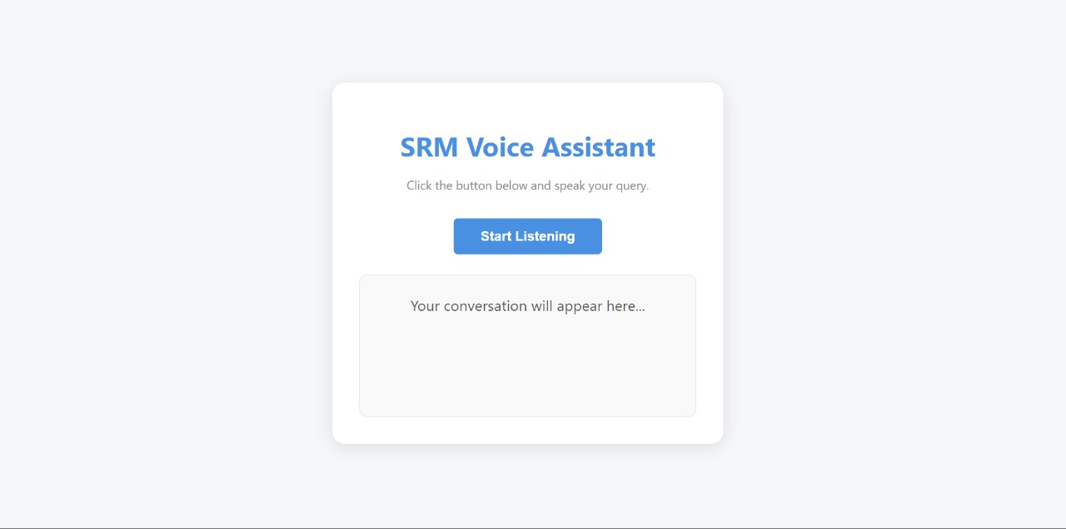
Sprint Activities-UI Design

Slide 43
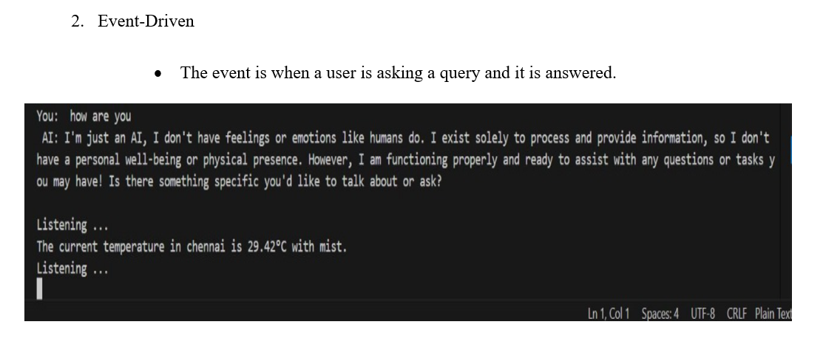
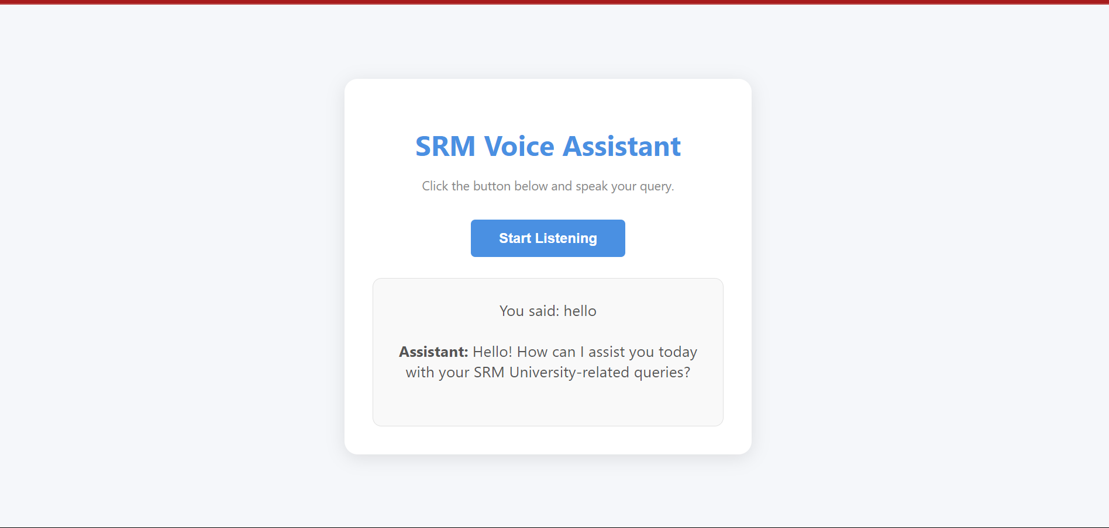
Sprint Activities-Architecture Document
Application
Microservices
Speech Recognition Microservice
LangChain Microservice
LLM Interaction Microservice
Text-to-Speech (TTS) Microservice
Audio Playback Microservice
Logging Microservice
Multi-threading and Queue Management Microservice
Perplexity evaluation

Slide 44
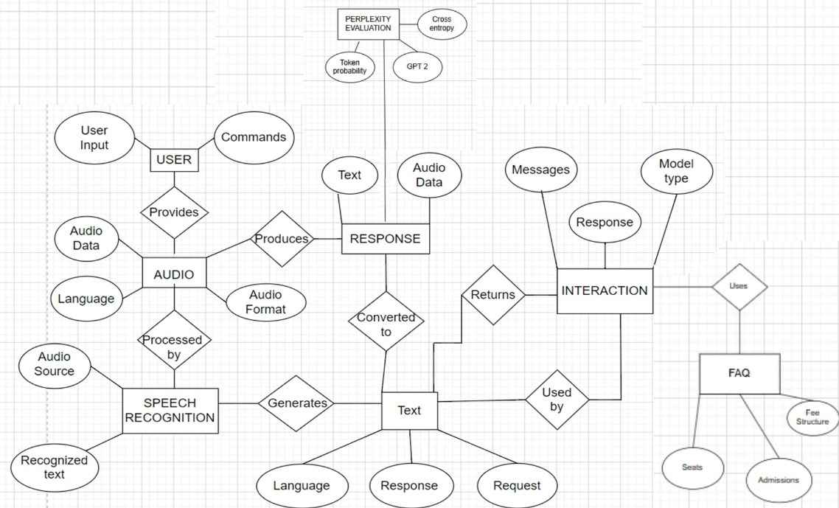
Sprint Activities-Architecture Document
ER Diagram

Slide 45
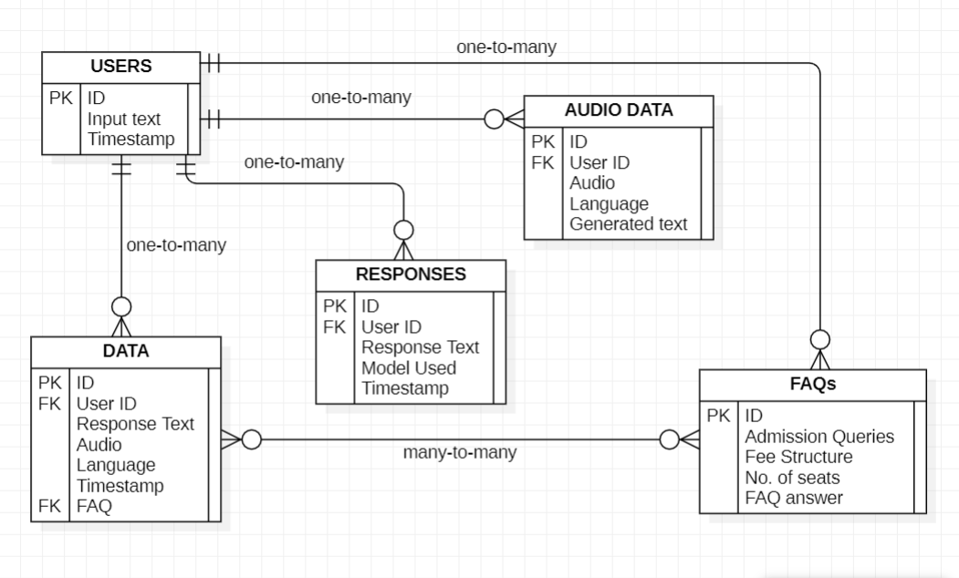
Sprint Activities-Architecture Document
Schema Diagram

Slide 46
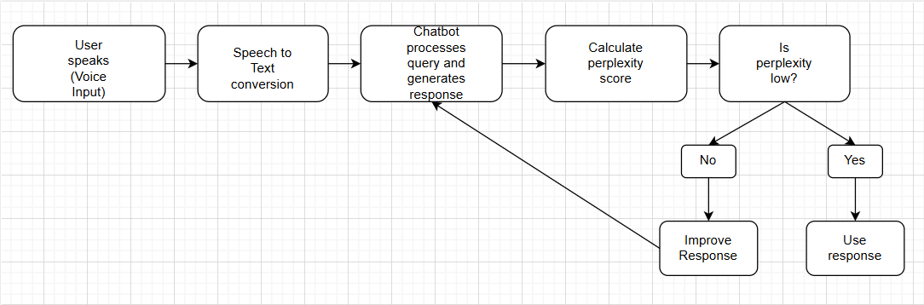
Sprint Activities-Architecture Document
Perplexity Evaluation Flowchart

Slide 47
Sprint Activities-Architecture Document
Data Exchange Contract
Frequency of data exchanges
Trigger: Data exchange occurs with each user voice query.
Request Frequency: On-demand, per query.
Response Time: Real-time after backend processing.
Data Format: JSON for all exchanges.
Completion: Exchange completes after receiving backend response.

Slide 48
Sprint Activities-Architecture Document
DataSet
https://github.com/amaaanmajid/datasetmajor/blob/main/formatted%20dataset%20faq%20major.docx
Mode of Exchanges (API, File, Queue etc.,)
• Mode of Exchange: HTTP API via POST requests.
• Frontend → Backend: API call with JSON data.
• Backend → Frontend: JSON response over HTTP.
• Data Transfer: Real-time over HTTP/HTTPS.
• Speech Output: Processed through Web Speech API on the frontend.

Slide 49
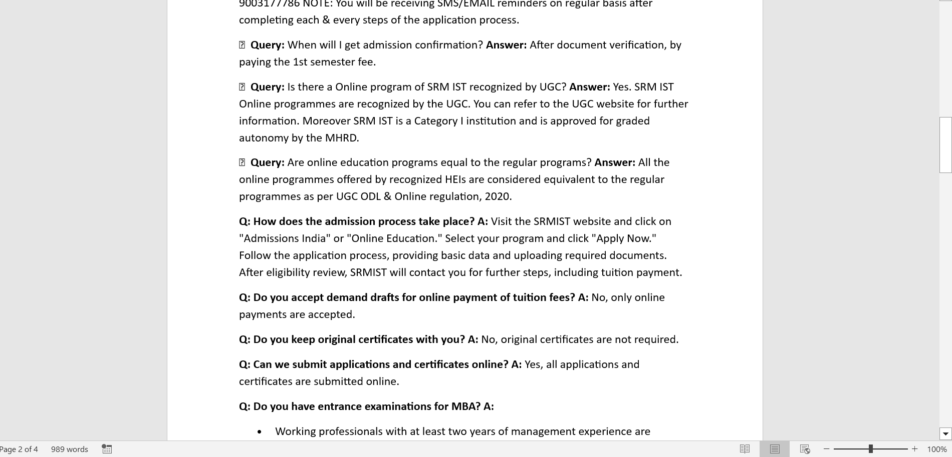
Sprint Activities-Architecture Document
Data Set

Slide 50
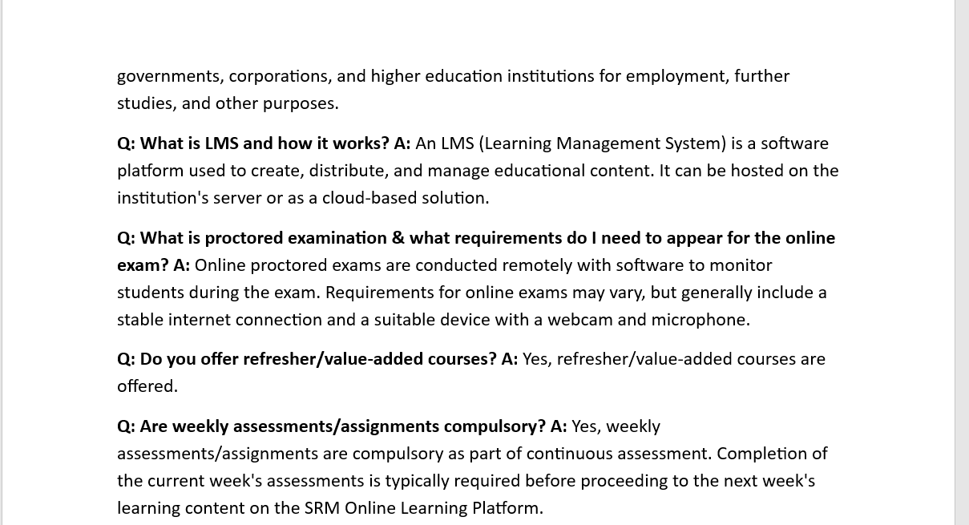
Sprint Activities-Architecture Document
Data Set

Slide 51
Sprint Activities-Architecture Document
Data Set
https://github.com/amaaanmajid/datasetmajor/blob/main/formatted%20dataset%20faq%20major.docx

Slide 52
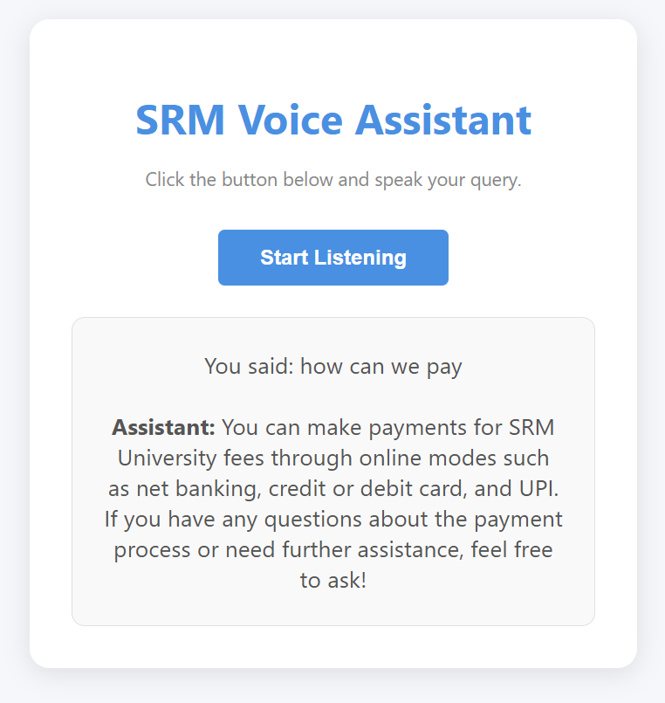
Sprint Activities-Demo of the Deliverable
Voice code output

Slide 53
Sprint Activities-Sprint Retrospective Document
https://docs.google.com/spreadsheets/d/1Rv6xP4mj45jy8W-t7XJjulNzx01a0wHR/edit?usp=drive_link&ouid=115284489621964487412&rtpof=true&sd=true

Slide 54
Methodology and Working
1.Frontend Setup (Voice Input & Display):
Voice Recognition: The frontend uses the Web Speech API.
API Call: Once the text is captured, the frontend sends it as a POST request to the backend API for processing.
Speech Synthesis: After receiving the response from the backend, the frontend converts the response back to speech using SpeechSynthesis.
2. Backend Processing (FastAPI):
API Endpoint: The backend is implemented using FastAPI and exposes an API.
Data Processing: The backend uses a LangChain-based model to process the query. This model handles the logic for generating responses related to SRM admissions.
Response: After processing the query, the backend returns the response to the frontend as a JSON object.

Slide 55
3. LangChain Model (SRM Assistant):
Prompt-Based Model: The backend uses a prompt template to generate SRM FAQ-specific answers based on the user's queries.
Contextual Responses: The LangChain model maintains session-specific history to provide context-aware responses during the interaction.
Data Flow: For each query, the input text is processed, the response is generated, and the output is sent back to the frontend.
4.Data Exchange (Client-Server Communication):
Mode: The mode of exchange is HTTP API, using POST requests for each query-response cycle.
Frequency: Data is exchanged on-demand in real-time as the user interacts with the voice assistant.
5. Error Handling:
Speech Recognition Errors: If there's an issue with recognizing the voice input, the frontend handles the error and displays a message.
API Communication Errors: If the backend is unreachable or an error occurs during processing, appropriate error messages are shown on the frontend.

Slide 56
Project Plan and Timeline
1. Dataset Update (March1 – March4)
Add additional FAQs from admissions office .
Refine and structure the dataset in the required format (JSON).
Validate dataset accuracy through team review.
2. Integration with Existing Chain (march 5 - March 15)
Feed the updated FAQ dataset into the developed chain.
Test chatbot response accuracy for new FAQs.
3. Testing and Debugging (March 16 - March 25)
Conduct end-to-end testing for both voice and text-based interactions.
Address edge cases and improve chatbot accuracy.
Document and fix identified bugs.

Slide 57
THANK YOU

